Slide 1
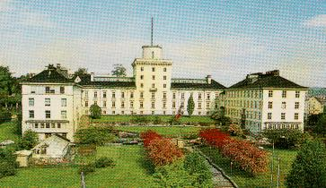


From observing system evidence to policy - What to do when the linear model of science fails?
Science-policy interface session
GEOSS Workshop, Bonn, August 2012
Peter M. Haugan, vice-chair of Intergovernmental Oceanographic Commission and Norwegian National Commission for UNESCO,
Professor at Geophysical Institute, University of Bergen, also affiliated with the Bjerknes Centre for Climate Research, and Nansen Environmental and Remote Sensing Center, Bergen.

Slide 2
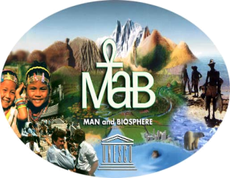

At least three UNESCO
science programmes relate directly to topics of this workshop – they are intergovernmental and integrate science with actions on the ground, best practices, capacity building etc.

Slide 3
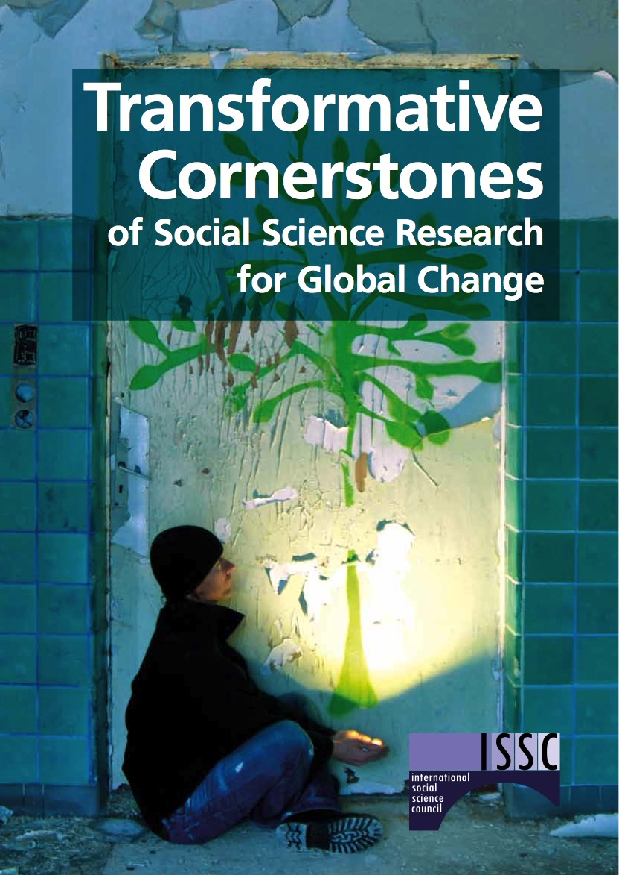
Recent report from ISSC
working closely with
UNESCO MOST
(Heide Hackmann and
Asunción Lera St. Clair)
ISSC works to increase production
and use of social, behavioural and
economic science knowledge that
can help to address key global
problems.
Refer also side event in Rio hosted
by the Norwegian Commission for
UNESCO, MOST and ISSC:
“Social science support to policies
promoting the social dimension
of sustainable development in a
changing climate”

Slide 4
Science – policy interface
Science following policy:
E.g. check progress towards Millennium Development Goals.
Policy derived directly from science:
Not so common, but Montreal protocol may be an example.
Role of science in policy development:
Complex issues, slow development of science understanding, need for decisions at time of incomplete understanding, need to consider other perspectives

Slide 5
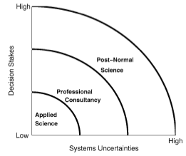
Climate science is post-normal science

Slide 6
Models of the role of science
The standard (modern) model: “… there is only one correct description of the system, and it is to be provided by science” (Funtowicz and Strand 2007)
2. The model of extended participation (essentially postnormal science): science should aid in making the correct decisions based on the current knowledge at hand. One important aspect of this method is the inclusion of non-experts, creating an “extended peer community” (Ravetz 2004).

Slide 7
Models of science
The epistemic or natural science model sees social scientists and social science professionals as technocrats who – through their insight into social theories and laws – may provide society with solutions to its social ills.
The phronetic model (Bent Flyvbjerg) sees social scientists and social science professionals as analysts who produce food for thought for the ongoing process of public deliberation, participation, and decision making.
I suggest that this applies to to natural science as well.

Slide 8
Robust public deliberation
Though imperfect, no better device than public deliberation following the rules of constitutional democracy has been arrived at for settling social issues, so far as human history can show. Social science must therefore play into this device if it is to be useful.
This is best done by (social) scientists:
(1) producing reflexive analyses of values and interests and of how values and interests affect different groups in society, and
(2) making sure that such analyses are fed into the process of public deliberation and decision making, in order to guarantee that legitimate parties to this process, i.e., citizens and stakeholders, receive due diligence in the process.

Slide 9
Remarks and questions for discussion
Given that complex global environmental issues define our present anthropocene era:
Is it so that the main role of science for complex environmental issues in future may be more to elevate public debate and to reveal political inconsistencies, rather than to give definite advice?
Is the division into three categories (1) science following policy, (2) science driving policy, and (3) more complex interactions, useful?
What should be the future role of GEO in science-policy interface? What can GEO contribute in the web of international and intergovernmental organizations?

Slide 10

Note this title of presentation from Rio
Making Knowledge Work
Heide Hackmann
International Social Science Council
20 June 2012

